Slide 1

Probability Foundations
Turning Uncertainty into Logic
Welcome everyone. Today we're going to build a mental toolkit to handle the unknown. We'll move step-by-step from "Why do we care?" to "How do we calculate it?"

Slide 2



1. The Nature of Uncertainty
Life is a Series of Unknowns
We rarely know exactly what will happen next. Will it rain? Will the stock market go up? Will you catch the bus?
To navigate life, we must think ahead about all possible outcomes before we make a decision.
Imagine standing in the fog. You can't see the destination. This is uncertainty. Before we move, we have to consider what *might* happen.

Slide 3

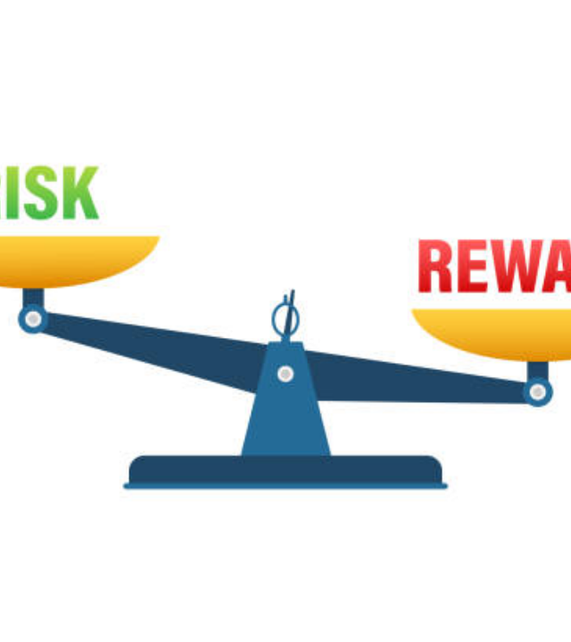
2. Evaluating Risk
Is it worth it?
We manage uncertainty by asking two critical questions:
•
What is the chance of success?
•
What is the chance of failure?
We stop guessing and start quantifying.
We treat decisions like a weighing scale. Probability is simply the tool we use to read the weight on that scale.

Slide 4






3. Why Study Probability?
Predict Patterns
Compare Risks
Make Decisions
Understand trends in data and weather.
Make rational choices, not emotional ones.
Choose the option with the best "odds".
It's not just math homework. It's about predicting the future (imperfectly) to make better choices today.

Slide 5

Checkpoint 1
Uncertainty exists → We evaluate Risk → Probability is our Tool.
Let's pause. We've established the "Why." Now let's move to the "What."

Slide 6
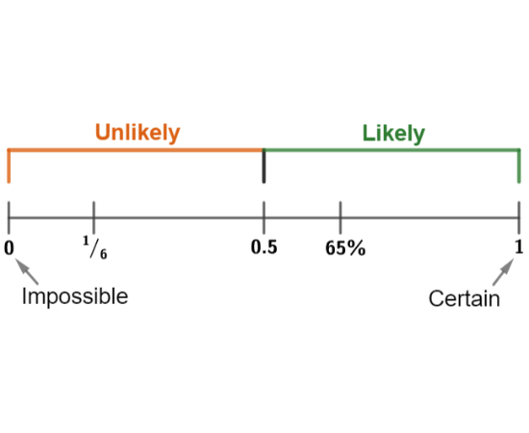
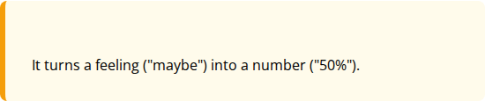
4. What is Probability?
"Probability is the numerical measure of how likely an event is to occur."
Simple Translation:
It's a translator. It takes vague words like "likely" or "rare" and turns them into precise numbers we can use.

Slide 7
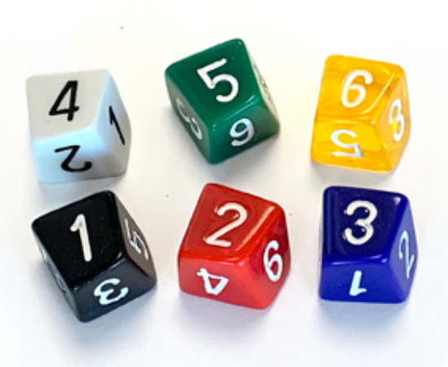
5. What is an "Event"?
An Event is a specific outcome (or group of outcomes) that we are interested in.
•
Example A: Getting "Heads" on a coin.
•
Example B: Rolling a "4" on a die.
Think of an event as the "target" we are aiming for. Here, our target is the number 4.

Slide 8
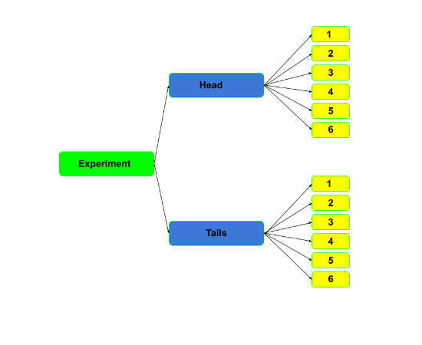
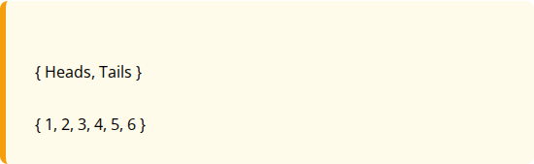
6. Sample Space
The Sample Space is the list of ALL possible outcomes that could happen.
For a Coin:
For a Die:
If it's not in the sample space, it's impossible.
The Sample Space is our "Universe." Nothing exists outside of it. For a die, "7" is not in the universe.

Slide 9



7. The Probability Scale (0 to 1)
0
0.5
1
Impossible
Uncertain
Certain
Rolling a 7 on a standard die.
Flipping a Coin (Heads/Tails).
The sun rising in the East.
We count from 0 to 1. 0 is "Never". 1 is "Always". Everything else lives in the middle.

Slide 10
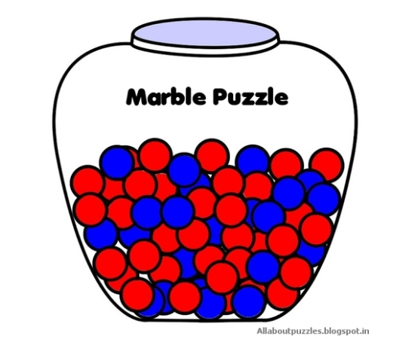
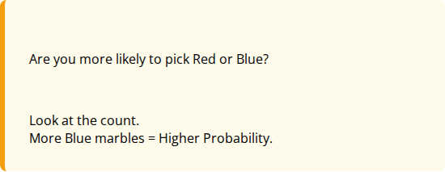
Interactive: Comparing Likelihood
Which is more likely?
Look at the jar. If you pick one marble with your eyes closed:
Question:
Answer:
Don't calculate yet, just look. Probability often starts with intuition—which color dominates the jar?

Slide 11
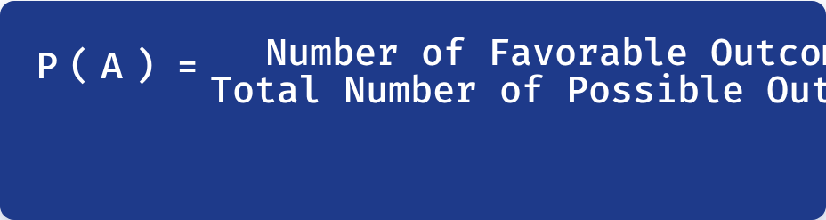
8. The Formula
How do we calculate the exact number?
Favorable = What you WANT.
Total = What you HAVE.
Memorize this: Part over Whole. The top is what you want to happen. The bottom is everything that could happen.

Slide 12
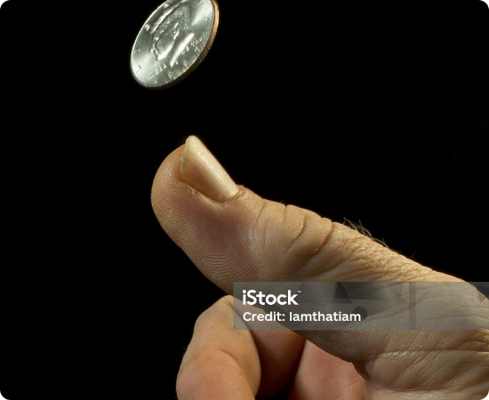

Example: Flipping a Coin
Calculating P(Heads)
1. Favorable: Heads (1 side)
2. Total: Heads + Tails (2 sides)
Simplest example. One winner, two possibilities. 1 divided by 2 is 0.5, or 50%.

Slide 13


Example: Rolling a 4
Calculating P(4)
1. Favorable: The face "4" (1 face)
2. Total: {1, 2, 3, 4, 5, 6} (6 faces)
Note: Having a "4" on the face doesn't mean the top number is 4. The count is 1.
Careful here. The top number of the fraction is NOT 4. It is 1. There is only ONE face that has a 4 on it.

Slide 14

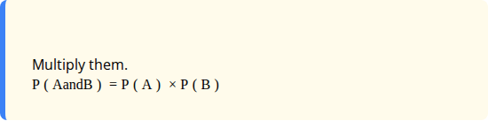
9. Independent Events
The "And" Rule
Events are Independent if one happening does not change the other.
Rule:
Example: Coin Head (1/2) AND Die 6 (1/6) = 1/12
The coin doesn't care what the die does. They are independent. When we want BOTH, it gets harder, so the probability shrinks (we multiply fractions).

Slide 15
Summary & Cheat Sheet
Concept | Key Idea | Formula / Value
Event (A) | The specific outcome we want | Subset of Sample Space
Sample Space (S) | All possible outcomes | Total Count
Probability P(A) | Likelihood of Event A | 0 (Impossible) to 1 (Certain)
The Formula | Part / Whole | P(A) = Favorable / Total
Independent | Events don't affect each other | P(A and B) = P(A) × P(B)
Here is your map. If you get lost, come back to this slide. Remember: Probability is just logic with numbers.

Slide 16







Image Sources
https://easy-peasy.ai/cdn-cgi/image/quality=95,format=auto,width=800/https://media.easy-peasy.ai/27feb2bb-aeb4-4a83-9fb6-8f3f2a15885e/eb5aef25-fe3a-499f-bc5b-ca799eed7ae2.png
Source: easy-peasy.ai
https://media.istockphoto.com/id/1432765838/vector/risk-vs-reward-balance-on-the-scale-balance-on-scale-business-concept-vector-stock.jpg?s=612x612&w=0&k=20&c=jIb5Oc4ublm2WNHx6gZFeINsU-RdWOqo9HxBveo7U-w=
Source: www.istockphoto.com
https://mmerevise.co.uk/app/uploads/2019/07/probability-figure-1.png
Source: mmerevise.co.uk
http://www.mathartfun.com/shopsite_sc/store/html/Skewd6Num.jpg
Source: www.mathartfun.com
https://media.geeksforgeeks.org/wp-content/uploads/20240111124220/ht.png
Source: www.geeksforgeeks.org
https://blogger.googleusercontent.com/img/b/R29vZ2xl/AVvXsEgDIM6dKMzhRfipuyEHeiBrJPpNjLDhigtAScZ6eujQok2hnSeAzlbnfRIVjiZ1GYlubLB9I-Im7HYmqtBZwldhE8Z-SDSixWzZVm94f4ZbUEsOWbsLwe_wR6rSNus3HwtKe3qmWo0v6O4/s640/9loyS71351085364.jpg
Source: allaboutpuzzles.blogspot.com

Slide 17


Image Sources
https://media.istockphoto.com/id/184222242/photo/close-up-photo-of-a-hand-flipping-a-coin-in-mid-air.jpg?s=1024x1024&w=is&k=20&c=KwQ7ry6B5xgVny2lckHXz2tKhtAM8aJVNrf_H8in5eA=
Source: www.istockphoto.com

